Slide 1
Coding AI
Game playing agents in python
Reboot.ai

Slide 2
Agenda
Who: Who is this guy?
Why: Why do we need intelligent algorithms? What do they solve?
What: What are algorithms/intelligent agents?
How: How do these algorithms actually work?
High Level Description
Technical Deep Dive
Code Walkthrough

Slide 3
About Me
Who?
BBA Emory University – Finance
Finance
Excel API Specialist – Bloomberg
Lead Investment Trader – Algorithmic Desk – Macro Hedge Fund
Development
Immersive Bootcamp & Self Taught
Full stack Web Developer: websites, apps, games, chatbots, open source, etc.
Professional Scrum Master (PSM I) & Professional Scrum Product Owner (PSPO I)
Avid futurist- AI, blockchain, IOT, & social ramifications
Reboot.ai
Hong Kong machine learning and AI educator
Courses for beginners and advanced
Curriculum developed in consultation with local data driven hiring companies

Slide 4
Algorithms
Why?
1) Computers can crunch decisions much faster than humans
Even complex problems have a finite set of answers in which ‘intelligence’ is really an optimization problem
Google maps, chess, cost minimization, efficient frontiers
2) Logic is replicable and scalable
Consistency of results beyond humanly possible
‘Man made’ algorithms start from intuition, thus can be more relatable than ‘black box’ type techniques like neural networks
3) Can incorporate elements of ‘learning’ from results
Can ‘learn’ and improve

Slide 5
Headline Use Cases
Why?
The world’s best Dota 2 players just got destroyed by a killer AI from Elon Musk’s startup
New work: Algorithms to give self-driving cars 'impulsive' human 'ethics’
A Load Scheduling Algorithm for the Smart Home Using Customer Preferences and Real Time Residential Prices
Google Is Changing Its Search Algorithm to Combat Fake News

Slide 6
Use Case Characteristics
Why?
Intelligent algorithms can be useful in ANY case where:
Large number of calculations
Any system with <100% uncertainty
Systems with high dimensional complexity
They DO NOT require:
Finite possibilities
Fully known environments
Problems humans can also solve just slower

Slide 7
Use Case Characteristics
Why?
Discrete vs Continuous
Ex. chess vs driving
Stochastic vs Known
Ex. ‘Luck’ games vs google maps
Fully observable vs partially observable
Ex. Smart home vs stock market
Individual vs Adversarial
Ex. Optimizing elevators vs cybersecurity

Slide 8
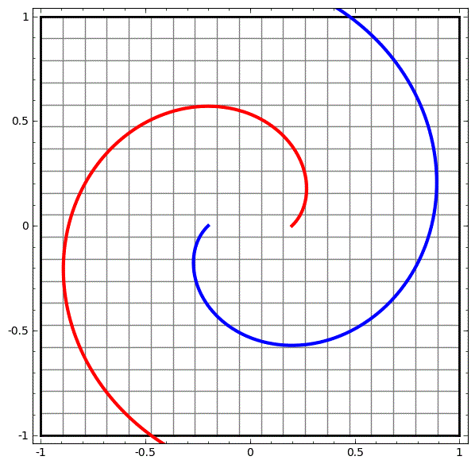
Think in >3 Dimensions
Why?

Slide 9

Easy for a machine…
Why?

Slide 10
Summary: Why?
Why?
Benefits
Can be faster and cheaper than human alternative
Can be employed in a wide variety of real world conditions and limited/flawed data
Can involve elements of learning
Weaknesses
Very difficult to generalize
No contextual understanding or ‘intuition’
Mistrusted and misunderstood
Questions at this point?

Slide 11
What is an Algorithm
What?
An algorithm is a step by step process for completing a task.
Everyday examples: recipes, ‘habits’, traditions, driving laws
Example in code:
getDressed(temp):
if (temp > 30):
putOn(shorts)
else
putOn(pants)
Algorithm knows what clothes to suggest for weather, but not occasion or event. Is it intelligent?

Slide 12
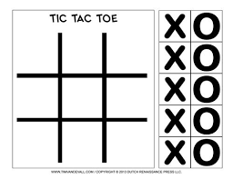
Tic-Tac-Toe Algorithm
What?
Let’s pseudo code an algorithm right now
If you were playing Tic-Tac-Toe as ‘O’ how would you decide to move?
Algorithm: a step by step process (rules of tic-tac-toe) for completing a task (winning)

Slide 13
Tic-Tac-Toe Algorithm
What?
It’s just tic-tac-toe, it doesn’t matter that much, when in doubt choose randomly
Check if we have 2 in a row and an empty space, play and win
Check if opponent has 2 in a row next to an empty space, block it
Imagine I played in a space how opponent would react… repeat
Try to play in spaces that maximize my connections while minimizing opponent’s

Slide 14
Algorithm Terminology – Heuristic
What?
Definition
‘Any approach to problem solving, learning, or discovery that employs a practical method not guaranteed to be optimal or perfect, but sufficient for the immediate goals.’ ‘A heuristic has no proof of correctness, often involves random elements, and may not yield optimal results.’
Example
finding the right water temperate for your shower turning it on hottest setting and decreasing to first comfortable state
Why it matters
David Hume and the starving donkey
In Tic-Tac-Toe
‘It’s just tic-tac-toe, it doesn’t matter that much, when in doubt choose randomly’

Slide 15
Algorithm Terminology – Constraint Propagation
What?
Definition
‘the process of finding a solution to a set of constraints that impose conditions that variables must satisfy’ or solving for values ‘that satisfies all constraints’
Example
When completing a puzzle, start with edge pieces, if a piece is not an edge, don’t bother checking if it fits or, deciding what to eat from a menu given your personal food allergies
Why it matters
How we actually begin to ‘solve’ the problem beyond pure brute force and guesses, lets us cut out steps
In Tic-Tac-Toe
To determine our move, ‘check if we have 2 in a row and an empty space, play and win’ and ‘check if opponent has 2 in a row next to an empty space, block it’

Slide 16
Algorithm Terminology – Search
What?
Definition
Creating a decision tree and iterating through evaluations of nodes (pure trial and error)
Example
When completing a puzzle, after filling in the edges, start sorting through all remaining pieces one by one until we find a fit
Why it matters
At some point, we may encounter a situation where there are multiple ‘equally good’ moves based on what is immediately known, thus we must start searching (trial and error) for an option [very different from applying a specific rule on what to do like ‘play only edge pieces’ for the puzzle]
In Tic-Tac-Toe
To determine our move, ‘check if we have 2 in a row and an empty space, play and win’ and ‘check if opponent has 2 in a row next to an empty space, block it’

Slide 17
Algorithm Terminology – Summary
What?
Heuristic: how to decide when there is no clear best answer, get to a ‘good enough’ answer and thus have to search much less
Constraint Propagation: applying rules that clearly cut out answers that are impossible or suboptimal
Search: if there are many potentially equal options (can’t cut any more out via constraint propagation) and none of the answers are yet ‘good enough’ (based on our heuristics), start evaluating remaining possibilities
…why not just use search if it gets us the best answer of all possible answers?

Slide 18
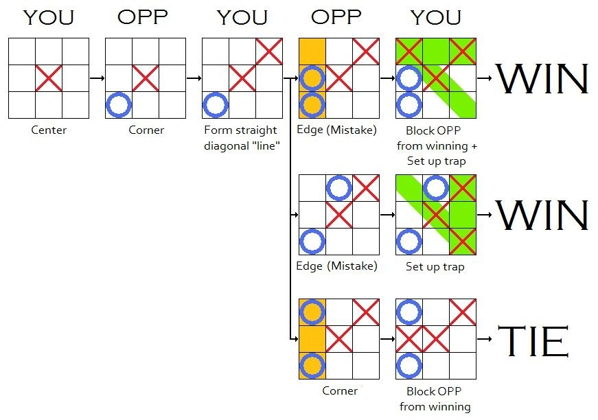
Tic-Tac-Toe Algorithm
What?

Slide 19
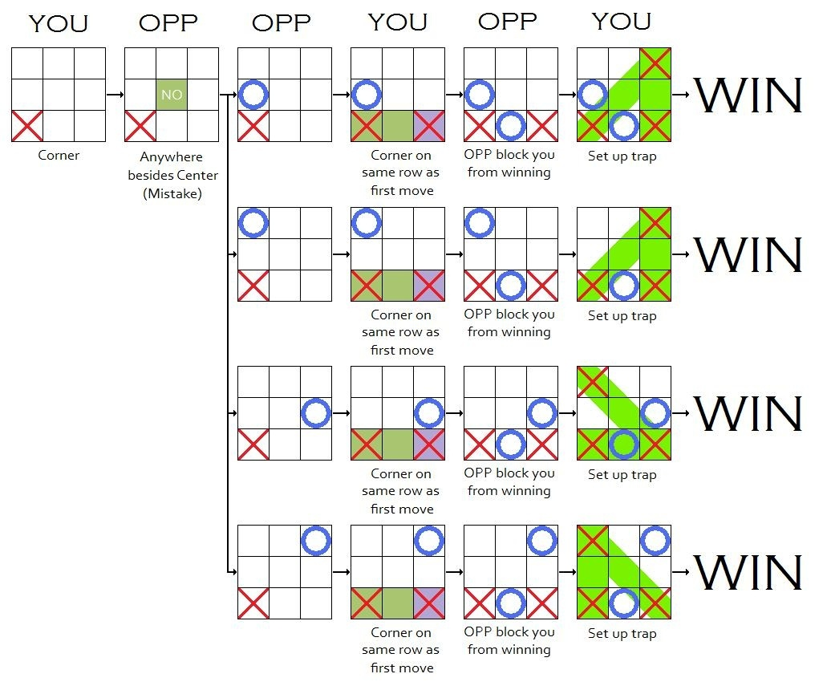
Tic-Tac-Toe Algorithm
What?

Slide 20
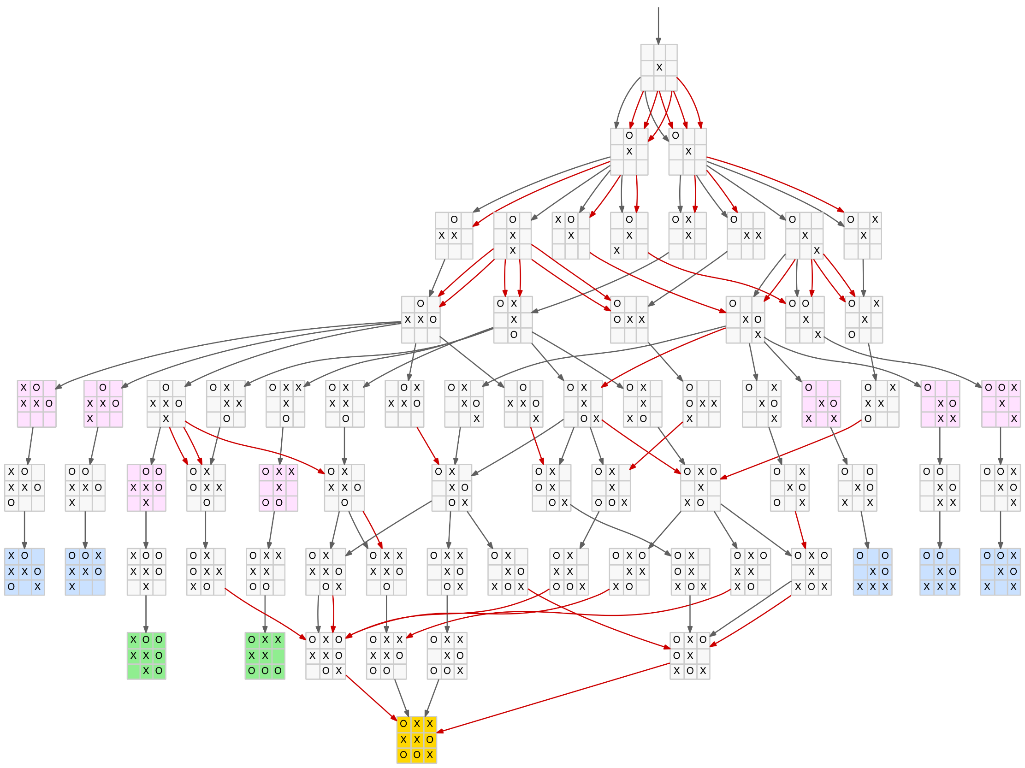
Tic-Tac-Toe Algorithm
What?

Slide 21
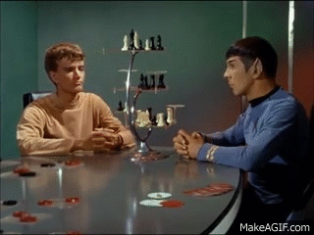
What about Chess?
What?
Chess is just like tic-tac-toe:
Fully observable
Limited outcomes
No randomness
Adversarial (Competitive)
Concluding we can just use search, like tic-tac-toe, would therefore be… logical

Slide 22
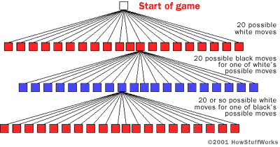
Tic-Tac-Toe Algorithm
What?
Start of game:
2 possible moves * 8 pawns
2 possible moves * 2 knights
20 moves per player
5 moves in is ~20^5 = 3,200,000
6 moves in = 64,000,000
Claude Shannon- Average games lasts around 40 moves, each move ~10^3 possibilities on average

Slide 23
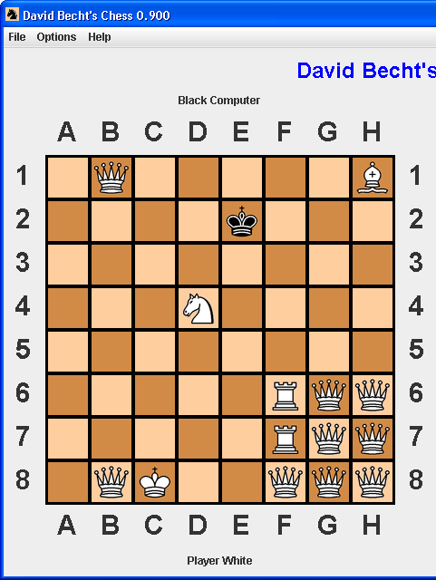
Tic-Tac-Toe Algorithm
What?
10^120 total possibilities > atoms in universe (10^75)
Chinese supercomputer 10^16 calculations per second
10^104 seconds to search entire game, or 3.2258065e+96 years
Universe is 13.772e+9 years old
But that doesn’t mean every possible position ‘makes sense’
Which is where the essence of heuristics, constrain propagation, and search algorithms come in…

Slide 24
Summary: What?
What?
High Level
An algorithm is a step by step process for completing a task
Intelligence is subjective and contextually dependent
An AI is an intelligent algorithm that can handle cases not explicitly coded
Deeper Dive
Heuristics (emotions), constraint propagation (logic/reason), search (experimentation)
Essence of an AI algorithm is finding ways to cut down on possibilities without trial and error (intuition)
Questions at this point?

Slide 25
How to Create an AI Algorithm
How?
Create a heuristic framework of how decisions should roughly be made
Codify constraints that are rules/laws/decisions based on the specifics of the case
Propagate the constraints
When you reach a point that has no obvious solution based on constraints:
Search through decision trees to find an answer
Pick an answer and update its probabilities based on feedback

Slide 26
Creating an AI - Heuristics
How?
Need to be a good tradeoff of necessary quality/accuracy and resources (time and computations)
Is used to rank branches before you search
Ex. In tic-tac-toe may have 3 possible moves, how do you pick which branch to explore first?
A heuristic such as ‘start with moves that link 2 of out cells together’ prioritizes with branches to start with- it may not be perfect, but should be better than randomly picking

Slide 27
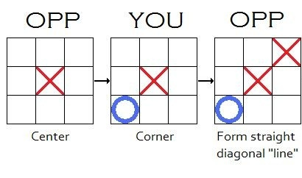
Creating an AI - Constraints
How?
Highly case dependent
Must be expressed mathematically/programmatically
Can be informed by other aspects of machine learning, doesn’t need to be ‘hard coded’
Propagating constraints is just applying these rules over and over until:
Get a result
Get stuck

Slide 28
Creating an AI - Search
How?
Needs to evaluate branches by some metric
Often can’t explore every branch, or explore any given branch fully (some situations are even infinite), so must make an informed tradeoff
Helpful to prioritize which branches to search
Multiple ways to search
1) Depth first
2) Breath first
3) Optimized methods

Slide 29
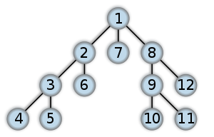
Search – Depth First
How?
1 > 2 > 3 > 4 > 3 > 5 > 3 > 2 > 6…
Advantages
Low memory usage (just node per depth level)
Potentially can find solution very quickly
Disadvantages
Doesn’t work with infinite depth (even finite graph can have infinite possibilities if self referral), thus no guarantee of solution
Can spend a lot of time on a ‘useless’ branch
Can be very slow to find ideal solutions (imagine if 8 is ideal)

Slide 30
Search – Breadth First
How?
1 > 2 > 1 > 7 > 1 > 8 > 2 > 3 > 2 > 6 >...
Advantages
Won’t get ‘trapped’ in an infinite tree
If solution exists, guaranteed to find it
Has a ‘broader’ view of possibilities than DFS at any given point in execution time
Disadvantages
High memory usage (each level of the tree must be saved in order to generate the next level)

Slide 31
Search – Iterative Deepening
How?
Runs a depth first search to increasing levels of depth
1 > 2, 1 > 7, 1 > 8 time check > 2 > 3 > 2 > 6…
Advantages
Won’t get ‘trapped’ in an infinite tree
Takes only DFS memory requirements with extremely minimal marginal time costs compared to BFS
Disadvantages
In graphs with repeating (duplicate nodes) IDS still has to check them (because no memory) while BFS can recognize them as duplicates and cut out (since all nodes saved in memory)

Slide 32
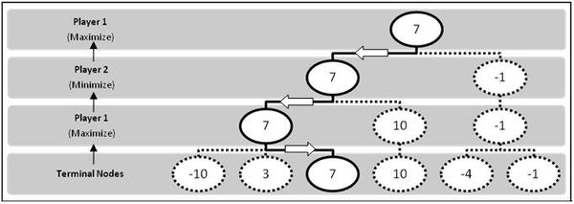
Search – Adversarial
How?
Up to now our search has assumed a given value independent of the observer (player)
What if we are searching moves though, should we assume opponent plays randomly?
We need a way to evaluate the quality of branches so we can choose between branches and make our best move on our turn, and assume opponent makes best move on theirs

Slide 33
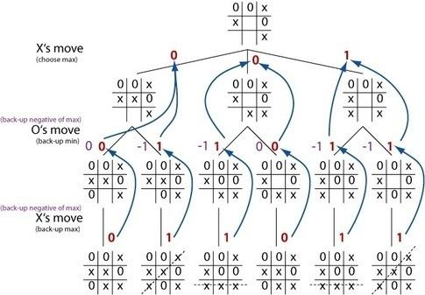
Minimax Algorithm
How?
Human creator of AI must decide ‘what to measure/maximize’ ie. number of moves, number of connected pieces, binary win conditions, points, etc…
Values flow from bottom (terminal node) to top
Note what you measure depends on
1) how correlated is it to desired state
2) how ‘deep’ you are required to search

Slide 34
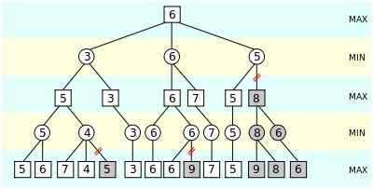
Alpha Beta Pruning
How?
Let’s us further cut down on calculations by trimming out nodes that don’t matter
Ie. if player A is going to maximize between two branches, and branch 1 is 5 pts and branch 2 is AT MOST 4 pts, no need to further explore branch 2

Slide 35
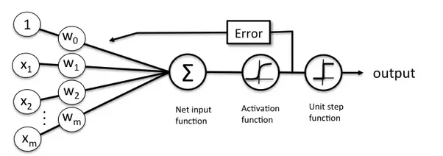
Machine Learning
How?
What happens if decision branches can’t be modeled or are unknown?
What happens if payoffs are unclear until after you take option?
Experiential learning:
Choose an option, compare outcome to desired state, update probability/weight of option in future
Machine learning techniques: support machine vectors, neural networks etc

Slide 36
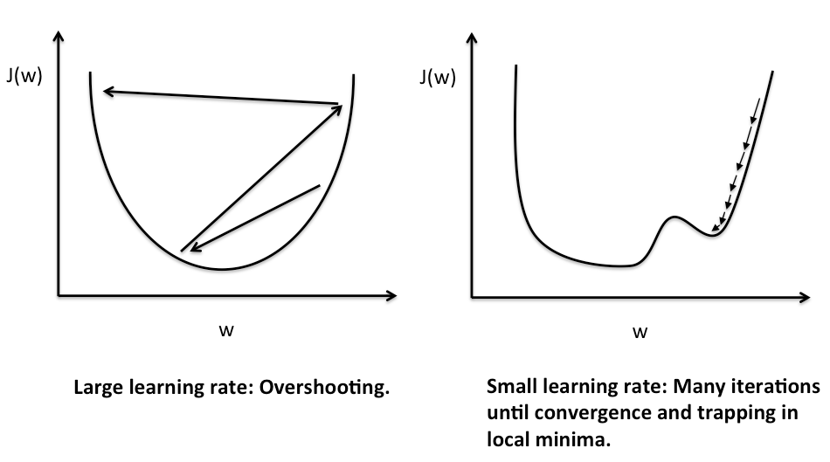
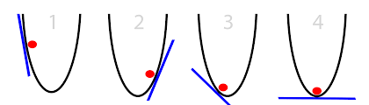
Machine Learning - Optimization
How?

Slide 37
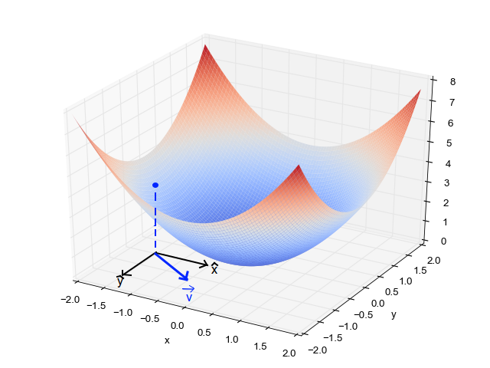
Machine Learning - Optimization
How?

Slide 38
How Do They Work? – Code
How?
Simple ‘tower defense’ game example
Python Sudoku solving AI algorithm
Questions so far?

Slide 39
Matt R O’Connor http://Reboot.ai 6289.9447 matt.oconnor217@gmail.com linkedin.com/in/mattroconnor/

Slide 40
Resources
https://www.quora.com/Is-there-a-way-to-never-lose-at-Tic-Tac-Toe
https://www.quora.com/How-exactly-does-a-chess-computer-work
http://intelligence.worldofcomputing.net/ai-search

